Slide 1

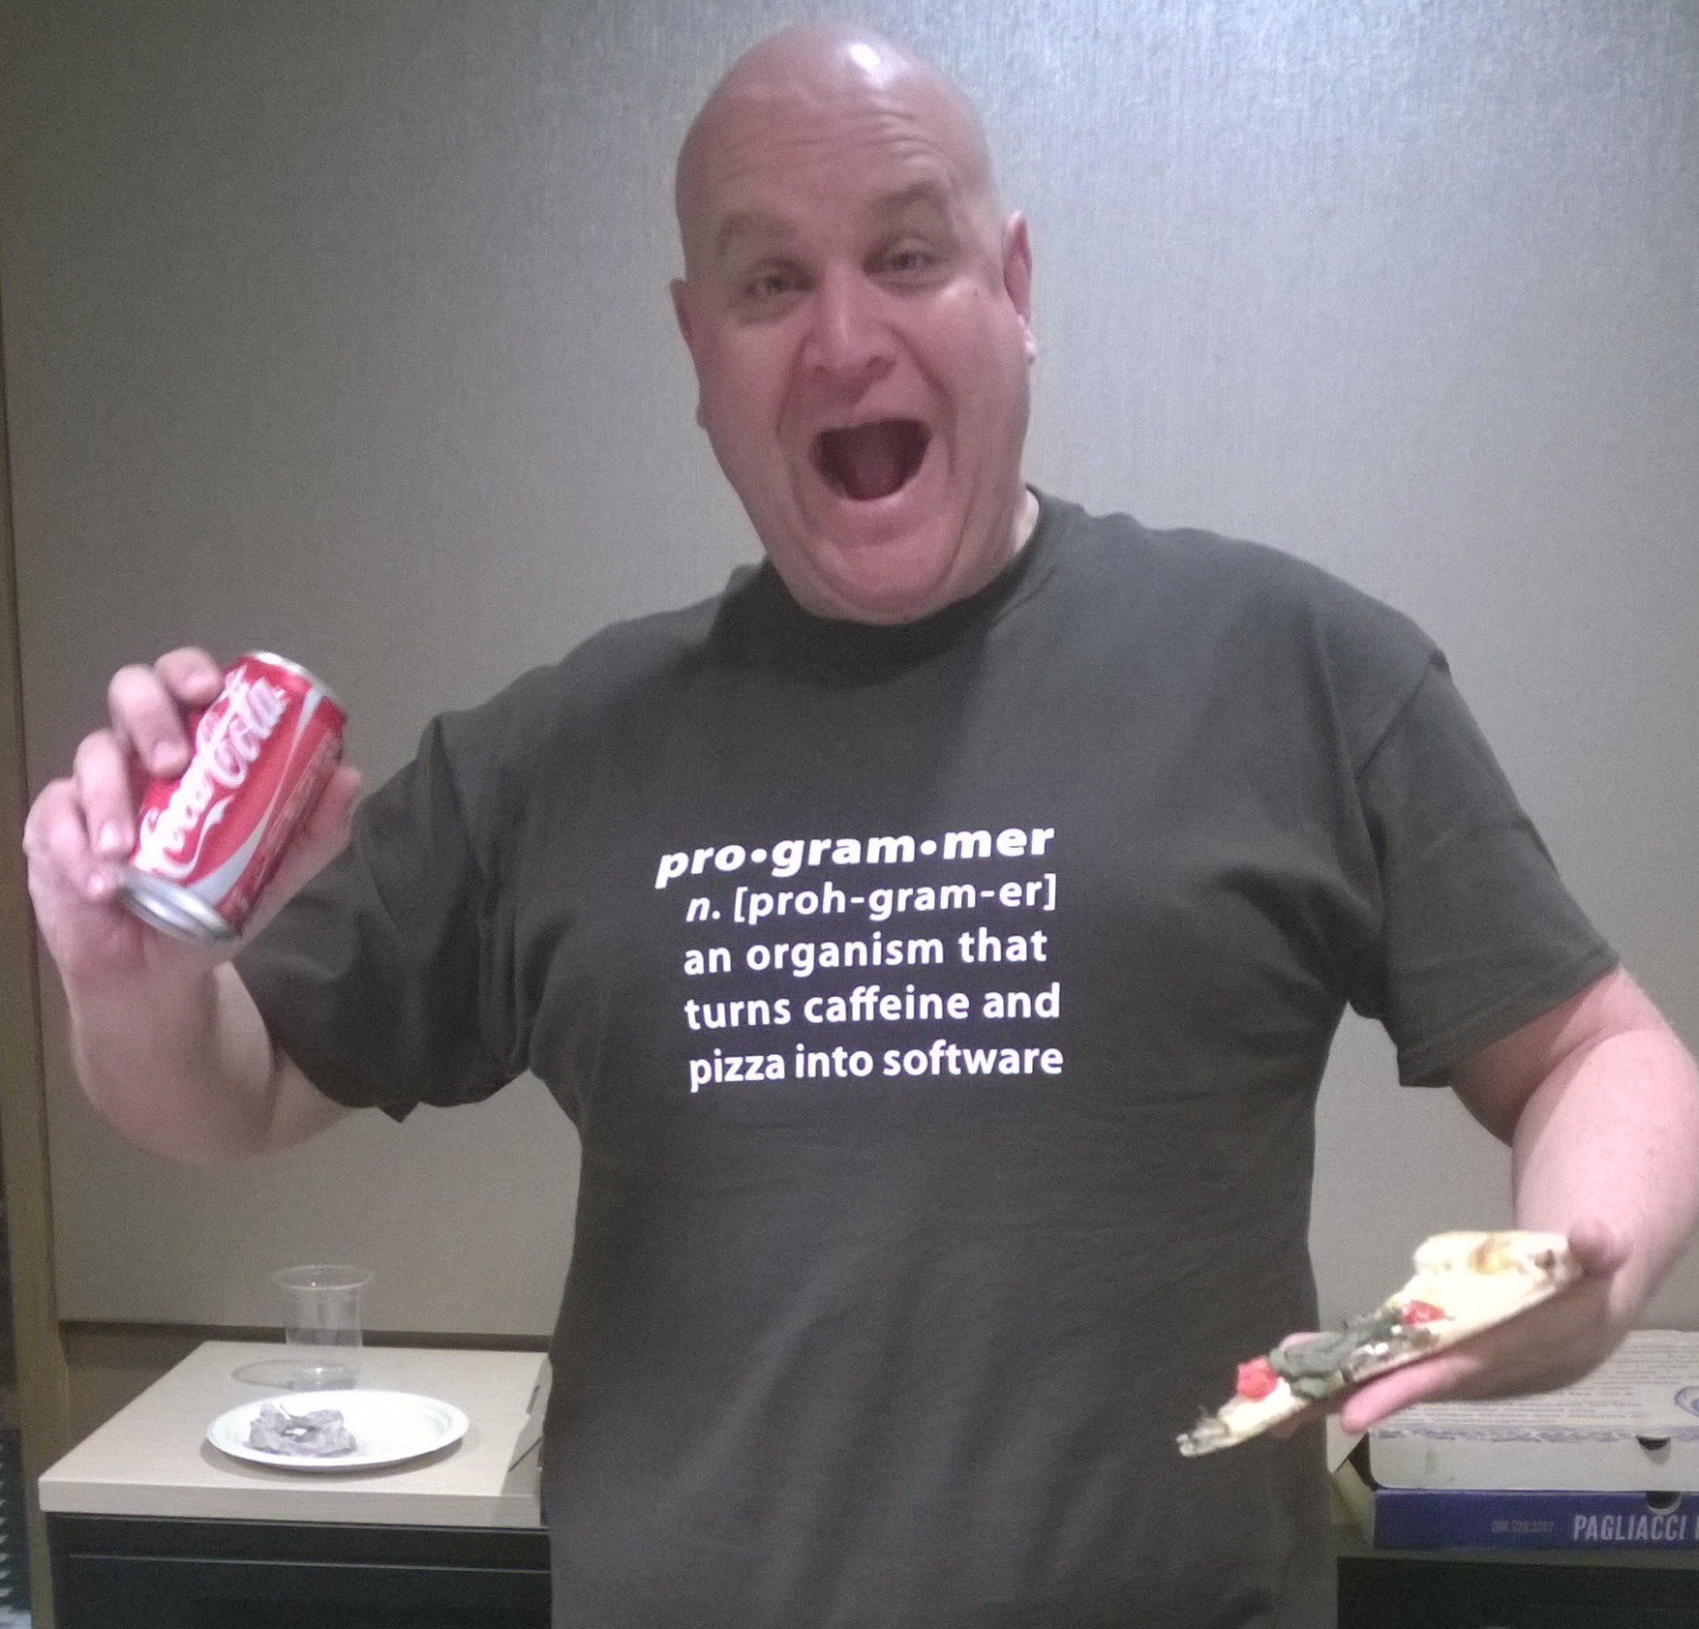

Modeling JSON data for document databases
Ryan CrawCour Program Manager, Microsoft @ryancrawcour | David Makogon Cloud Architect, Microsoft @dmakogon

Slide 2
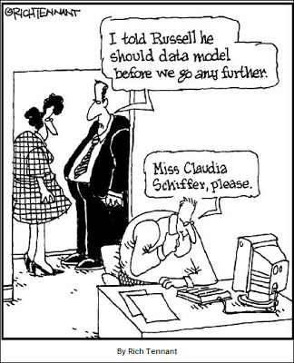
Today’s talk
What are document databases?
What is Azure DocumentDB?
Modeling data for a document database
Loud applause and lots of great tweets about #DocumentDB @ #CloudDevelop !

Slide 3
Kinds of databases
Relational
Column
Key Value
Graph
Document

Slide 4
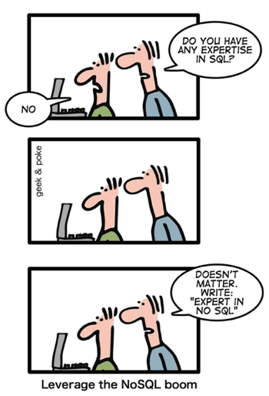
What are document databases?
Notes:
Jump to portal to show features

Slide 5
Document Databases
{
"name": "SmugMug",
"permalink": "smugmug",
"homepage_url": "http://www.smugmug.com",
"blog_url": "http://blogs.smugmug.com/",
"category_code": "photo_video",
"products": [
{
"name": "SmugMug",
"permalink": "smugmug"
}
],
"offices": [
{
"description": "",
"address1": "67 E. Even Ave, Suite 200",
"address2": "",
"zip_code": "94041",
"city": "Mountain View",
"state_code": "CA",
"country_code": "USA",
"latitude": 37.390056,
"longitude": -122.067692
}
]
}
Part of NoSQL family
Built for simplicity
Built for scale and performance
Non-relational
No enforced schema
Great for these documents …

Slide 6
Document Databases
{
“id": “itemdata2344",
“data": “TWFuIGlzIGRpc3Rpbmd1aXNoZWQsIG5vd cyByZWFzb24sIGJ1dCBieSB0aGlzHNpbmd1bG nJvbSBvdGhlciBhbmltYWxzLCB3aGljaCBpcyYg
dGhlIG1pbmQsIHRoYXQgYnkgYSBwZXJzZXZlsaW dodCBpbiB0aGUgY29udGludWVkIGFuZCBpbGdl bmVyYXRpb24gb2Yga25vd2xlZGdlLCBleGNlZ9y
dCB2ZWhlbWVuY2Ugb2YgYW55IGNhcm5hS4=
cyByZWFzb24sIGJ1dCBieSB0aGlzHNpbmd1bGFyIZ nJvbSBvdGhlciBhbmltYWxzLCB3aGljaCBpcyBh2Yg
dGhlIG1pbmQsIHRoYXQgYnkgYSBwZXJzZXZlGVsaW dodCBpbiB0aGUgY29udGludWVkIGFuZCBpbmRlZGdl bmVyYXRpb24gb2Yga25vd2xlZGdlLCBleGNlZWG9y dCB2ZWhlbWVuY2Ugb2YgYW55IGNhcm5hbS4=
cyByZWFzb24sIGJ1dCBieSB0aGlzHNpbmd1bGF4gZ nJvbSBvdGhlciBhbmltYWxzLCB3aGljaCBpg
dGhlIG1pbmQsIHRoYXQgYnkgYSBwZXJzZXZlcmVsaW dodCBpbiB0aGUgY29udGludWVkIGFuZCBpbmRlIGdl bmVyYXRpb24gb2Yga25vd2xlZGdlLCBleGNlZzaG9y dCB2ZWhlbWVuY2Ugb2YgYW55IGNhcm5hbCBwZS4=”
}
Part of NoSQL family
Built for simplicity
Built for scale and performance
Non-relational
No enforced schema
Not ideal for these documents …

Slide 7


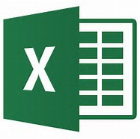
Document Databases
Part of NoSQL family
Built for simplicity
Built for scale and performance
Non-relational
No enforced schema
And definitely not for these kind of documents …

Slide 8
Azure DocumentDB: Lightning Round Edition
{
name:"Azure DocumentDB",
deployedAs: "Service",
dbType: "Document",
connectVia: [ "rest", "sdk" ],
deployVia: [ "portal", "rest", "cli", "sdk" ],
scaleVia: [ "portal", "rest", "cli", "sdk" ],
differsVia: [ "js", "indexing", "consistency" ]
}
Notes:
Jump to portal to show features

Slide 9
Service consumption
{
units:"RequestUnit",
timePeriod: "per second",
tiers: [250, 1000, 2500],
billedBy: "hour",
behavior: [ "consistent", "predictable" ],
measured: "per operation",
reportedVia: "result header"
}
Notes:
Jump to portal to show features

Slide 10
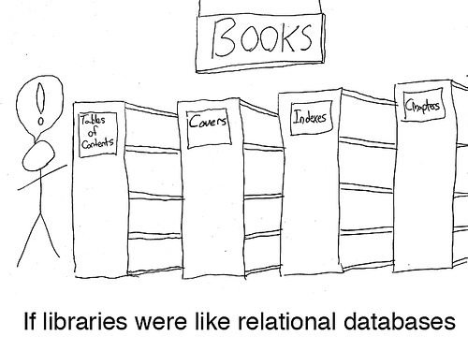
Modeling JSON data in this brave "new" world

Slide 11
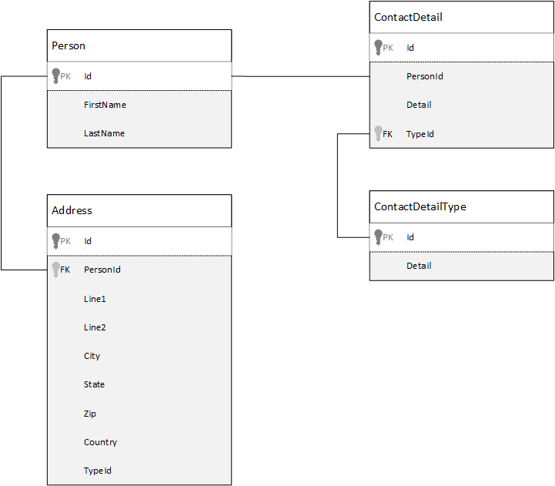
Modeling data, the relational way

Slide 12

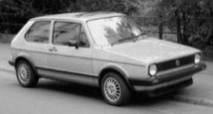


How do approaches differ?
ORM
Data normalization
Come as you are
Notes:
instead of taking the business subject / domain entity and breaking it up into multiple relational structures store the business subject in the minimal number of documents.

Slide 13
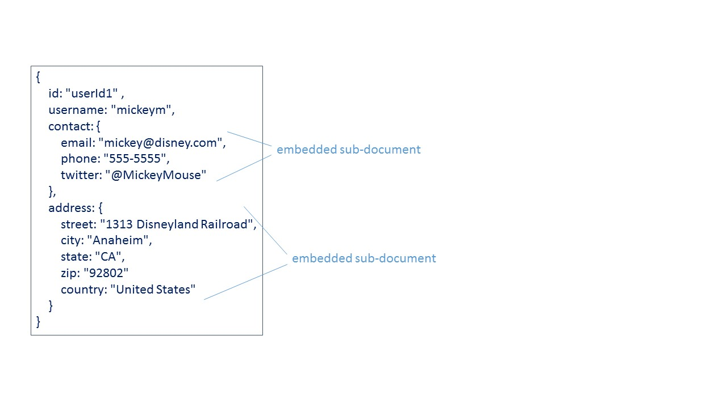
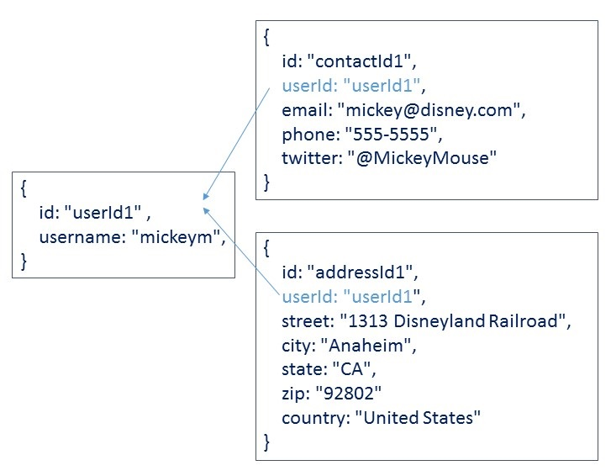
To embed, or to reference, that is the question
embed
reference
Notes:
Add diagram showing the differences

Slide 14
To embed, or to reference, that is the question
Data from entities are queried together

Slide 15





To embed, or to reference, that is the question
Data from entities are queried together

Slide 16
To embed, or to reference, that is the question
Data from entities are queried together
{
id: "book1",
covers: [
{type: "front", artworkUrl: "http://..."},
{type: "back", artworkUrl: "http://..."}
]
index: "",
chapters: [
{id: 1, synopsis: "", quote: "", pageCount:24, wordCount:456},
{id: 1, synopsis: "", quote: "", pageCount:24, wordCount:456},
]
}

Slide 17
To embed, or to reference, that is the question
Data from entities are queried together
The child is a dependent e.g. Order Line depends on Order
{
id: "order1",
customer: "customer1",
orderDate: "2014-09-15T23:14:25.7251173Z"
lines: [
{product: "13inch screen" , price: 200.00, qty: 50 },
{product: "Keyboard", price:23.67, qty:4}
{product: "CPU", price:87.89, qty:1
]
}

Slide 18
To embed, or to reference, that is the question
Data from entities are queried together
The child is a dependent e.g. Order Line depends on Order
1:1 relationship
{
id: "person1",
name: "Mickey"
creditCard: {
number: "**** **** **** 4794"},
expiry: "06/2019"},
cvv: "868",
type: "Mastercard"
}
}

Slide 19
To embed, or to reference, that is the question
Data from entities are queried together
The child is a dependent e.g. Order Line depends on Order
1:1 relationship
Similar volatility
{
id: "person1",
name: "Mickey",
contactInfo: [
{email: "mickey@disney.com"},
{mobile: "+1 555-5555"},
{twitter: "@MickeyMouse"}
]
}

Slide 20
To embed, or to reference, that is the question
Data from entities are queried together
The child is a dependent e.g. Order Line depends on Order
1:1 relationship
Similar volatility
The set of values or sub-documents is bounded (1:few)
{
id: "task1",
desc: "deliver an awesome presentation @ #CloudDevelop",
categories: ["conference", "talk", "workshop", "business"]
}

Slide 21
To embed, or to reference, that is the question
Data from entities are queried together
The child is a dependent e.g. Order Line depends on Order
1:1 relationship
Similar volatility
The set of values or sub-documents is bounded (1:few)
Typically denormalized data models provide better read performance

Slide 22
To embed, or to reference, that is the question
one-to-many relationships (unbounded)
{
id: "post1",
author: "Mickey Mouse",
tags: [ "fun", "cloud", "develop"]
}
{id: "c1", postId: "post1", comment: "Coolest blog post"}
{id: "c2", postId: "post1", comment: "Loved this post, awesome"}
{id: "c3", postId: "post1", comment: "This is rad!"}
…
{id: "c10000", postId: "post1", comment: "You are the coolest cartoon character"}
…
{id: "c2000000", postId: "post1", comment: "Are we still commeting on this blog?"}
Notes:
e.g.
application for efficient data entry of product orders
Order contains over 100 fields
Order Line contains over 50 fields
Product contains over 150 fields
An order on avg contains 20 lines
- Would you embed order lines on to order? Yes, Order Line is dependant on Order. Most of the time Order & Order line would be read together
- Would you embed product on to order line? No. Perhaps, but maybe just the info from product we need.
- What about requirement to support effecient data entry? Would having Order Line seperate be more effecient from a data entry point of view?
- What about the number of Order Lines? 20 is not unbounded.

Slide 23
To embed, or to reference, that is the question
one-to-many relationships (unbounded)
many-to-many relationships
{
id: "author1",
name: "Mickey Mouse"
}
{
id: "author2",
name: "Donald Duck"
}
{
author-id: "author1",
book-id: "book1"
}
{
author-id: "author2",
book-id: "book1"
}
{
id: "book1",
name: "100 Secrets of Disneyland"
}
{
id: "book2",
name: "The best places to eat @ Disney"
}
Look familiar?
It should …. It's the "relational" way
Notes:
e.g.
application for efficient data entry of product orders
Order contains over 100 fields
Order Line contains over 50 fields
Product contains over 150 fields
An order on avg contains 20 lines
- Would you embed order lines on to order? Yes, Order Line is dependant on Order. Most of the time Order & Order line would be read together
- Would you embed product on to order line? No. Perhaps, but maybe just the info from product we need.
- What about requirement to support effecient data entry? Would having Order Line seperate be more effecient from a data entry point of view?
- What about the number of Order Lines? 20 is not unbounded.

Slide 24
To embed, or to reference, that is the question
one-to-many relationships (unbounded)
many-to-many relationships
{
id: "author1",
name: "Mickey Mouse",
books: ["book1", "book2"]
}
{
id: "author2",
name: "Donald Duck"
books: ["book1"]
}
{
id: "book1",
name: "100 Secrets of Disneyland",
authors: ["author1", "author2"]
}
{
id: "book2",
name: "The best places to eat @ Disney”,
authors: ["author1"]
}
Notes:
e.g.
application for efficient data entry of product orders
Order contains over 100 fields
Order Line contains over 50 fields
Product contains over 150 fields
An order on avg contains 20 lines
- Would you embed order lines on to order? Yes, Order Line is dependant on Order. Most of the time Order & Order line would be read together
- Would you embed product on to order line? No. Perhaps, but maybe just the info from product we need.
- What about requirement to support effecient data entry? Would having Order Line seperate be more effecient from a data entry point of view?
- What about the number of Order Lines? 20 is not unbounded.

Slide 25
To embed, or to reference, that is the question
one-to-many relationships (unbounded)
many-to-many relationships
Related data changes frequently
The referenced entity is a key entity used by many others
{
id: "person1", author: "Mickey Mouse", stocks: [ "dis", "msft", "nflx"]
}
{
id: "dis",
opening: "52.09",
numerOfTrades: 10000,
trades: [{time: 083745, qty:57, price: 53.97}, {time: 083746, qty:5, price: 54.01}]
}
Notes:
e.g.
application for efficient data entry of product orders
Order contains over 100 fields
Order Line contains over 50 fields
Product contains over 150 fields
An order on avg contains 20 lines
- Would you embed order lines on to order? Yes, Order Line is dependant on Order. Most of the time Order & Order line would be read together
- Would you embed product on to order line? No. Perhaps, but maybe just the info from product we need.
- What about requirement to support effecient data entry? Would having Order Line seperate be more effecient from a data entry point of view?
- What about the number of Order Lines? 20 is not unbounded.

Slide 26
To embed, or to reference, that is the question
one-to-many relationships (unbounded)
many-to-many relationships
Related data changes frequently
The referenced entity is a key entity used by many others
Typically normalizing provides better write performance.
Normalized data models can require more round trips to the server.
Notes:
e.g.
application for efficient data entry of product orders
Order contains over 100 fields
Order Line contains over 50 fields
Product contains over 150 fields
An order on avg contains 20 lines
- Would you embed order lines on to order? Yes, Order Line is dependant on Order. Most of the time Order & Order line would be read together
- Would you embed product on to order line? No. Perhaps, but maybe just the info from product we need.
- What about requirement to support effecient data entry? Would having Order Line seperate be more effecient from a data entry point of view?
- What about the number of Order Lines? 20 is not unbounded.

Slide 27
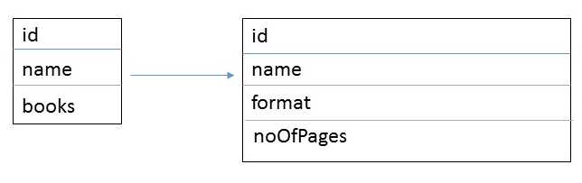
Where do you put the reference?
Publisher & Book … does publisher refer to book?
Publisher document:
{
id: "mspress",
name: "Microsoft Press",
books: [ 1, 2, 3, ..., 100, ..., 1000]
}
Book documents:
{id: 1, name: "DocumentDB 101" }
{id: 2, name: "DocumentDB for RDBMS Users" }
{id: 3, name: "Taking over the world one JSON doc at a time" }

Slide 28
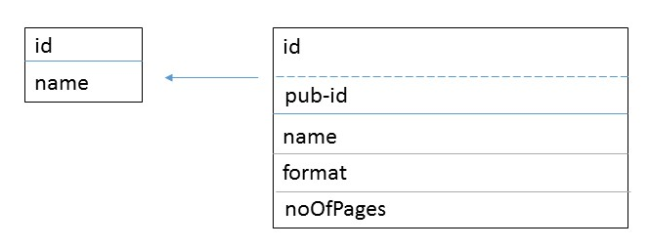
Where do you put the reference?
Publisher & Book … does or book refer to publisher?
Publisher document:
{
id: "mspress",
name: "Microsoft Press",
books: [ 1, 2, 3, ..., 100, ..., 1000]
}
Book documents:
{id: 1, name: "DocumentDB 101", pub-id: "mspress"}
{id: 2, name: "DocumentDB for RDBMS Users", pub-id: "mspress"}
{id: 3, name: "Taking over the world one JSON doc at a time", pub-id: "mspress"}

Slide 29
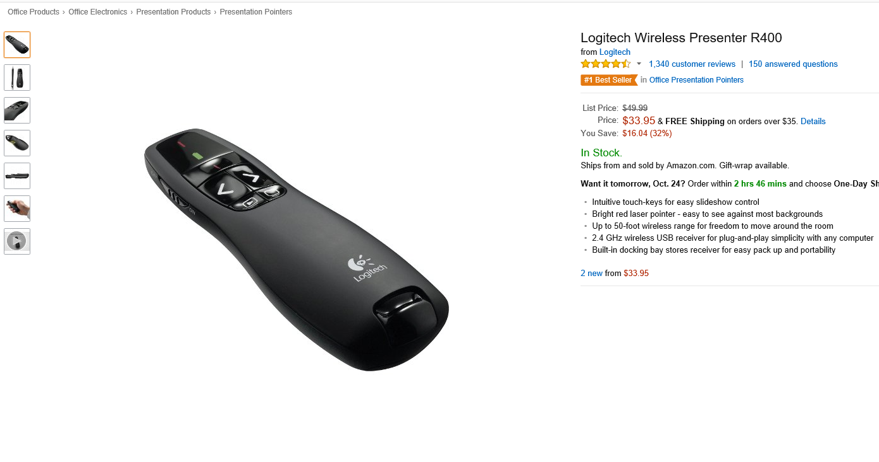
Is it always black or white?
Notes:
Denormalize some data and reference other data for a hybrid model
Remember, model as your application is going to use it
The danger of this is if the author changes their name or bio then you need to go update every book they have authored
Luckily DocumentDB allows multi-document transactions so this would be possible to do in a single atomic transaction
Similarly if the author changed their thumbnail picture you need to go update every book, or would you? You might want to keep the image of what the author looked like when a particular book was published.
So here denormalizing is actually useful, because you get a snapshot in time unlike pure referencing

Slide 30
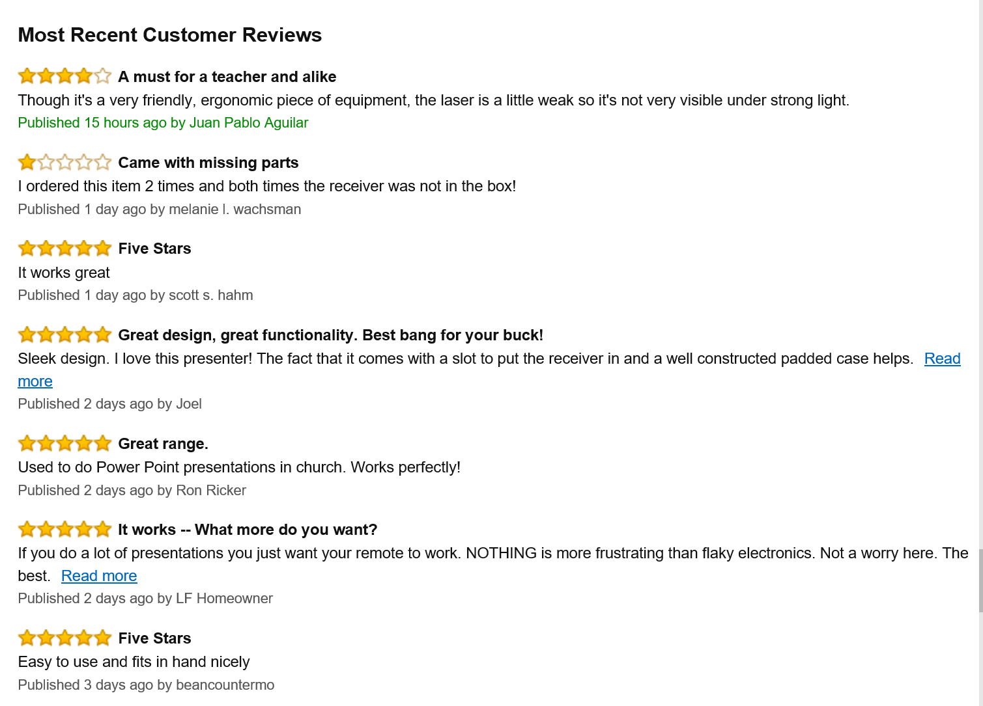
Is it always black or white?
Notes:
Denormalize some data and reference other data for a hybrid model
Remember, model as your application is going to use it
The danger of this is if the author changes their name or bio then you need to go update every book they have authored
Luckily DocumentDB allows multi-document transactions so this would be possible to do in a single atomic transaction
Similarly if the author changed their thumbnail picture you need to go update every book, or would you? You might want to keep the image of what the author looked like when a particular book was published.
So here denormalizing is actually useful, because you get a snapshot in time unlike pure referencing

Slide 31
Is it always black or white?
{
id: 1,
name: "DocumentDB 101",
authors": [
{
id: 1,
name: "Mickey Mouse",
bio: "Mickey Mouse is a funny animal cartoon character and the official mascot of The Walt Disney Company…",
thumbnailUrl: "http://....png"
}
]
}
{
id: 1,
firstName: "Mickey",
lastName: "Mouse",
books: [1, 2, 3],
images: [
{"thumbnail": "http://....png"},
{"profile": "http://....png"},
],
bio: "Mickey Mouse is a funny animal cartoon character and the official mascot of The Walt Disney Company. An anthropomorphic mouse who typically wears red shorts, large yellow shoes, and white gloves, Mickey has become one of the most recognizable cartoon characters."
}
Notes:
Denormalize some data and reference other data for a hybrid model
Remember, model as your application is going to use it
The danger of this is if the author changes their name or bio then you need to go update every book they have authored
Luckily DocumentDB allows multi-document transactions so this would be possible to do in a single atomic transaction
Similarly if the author changed their thumbnail picture you need to go update every book, or would you? You might want to keep the image of what the author looked like when a particular book was published.
So here denormalizing is actually useful, because you get a snapshot in time unlike pure referencing

Slide 32
How to model hierarchical trees?
{
{ id: "Jill" },
{ id: "Ben", manager: "Jill" },
{ id: "Susan", manager: "Jill" },
{ id: "Andrew", manager: "Ben" },
{ id: "Sven", manager: "Susan" },
{ id: "Thomas", manager: "Sven" }
}
Jill
Ben
Susan
Andrew
Sven
Thomas
To get the manager of any employee is trivial -
SELECT manager FROM org WHERE id = "Susan"

Slide 33
How to model hierarchical trees?
{
{ id: "Jill" },
{ id: "Ben", manager: "Jill" },
{ id: "Susan", manager: "Jill" },
{ id: "Andrew", manager: "Ben" },
{ id: "Sven", manager: "Susan" },
{ id: "Thomas", manager: "Sven" }
}
Jill
Ben
Susan
Andrew
Sven
Thomas
To get all employees where Jill is the manager is also easy -
SELECT * FROM org WHERE manager = "Jill"

Slide 34
How to model hierarchical trees?
{
{ id: "Jill", directs: ["Ben", "Susan"] },
{ id: "Ben", directs: ["Andrew"] },
{ id: "Susan", directs: ["Sven"] },
{ id: "Andrew" },
{ id: "Sven", directs: ["Thomas"] },
{ id: "Thomas" }
}
Jill
Ben
Susan
Andrew
Sven
Thomas
To get all direct reports for Jill is easy -
SELECT * FROM org WHERE id = "Jill"

Slide 35
How to model hierarchical trees?
{
{ id: "Jill", directs: ["Ben", "Susan"] },
{ id: "Ben", directs: ["Andrew"] },
{ id: "Susan", directs: ["Sven"] },
{ id: "Andrew" },
{ id: "Sven", directs: ["Thomas"] },
{ id: "Thomas" }
}
Jill
Ben
Susan
Andrew
Sven
Thomas
To find the manager for an employee is possible -
SELECT * FROM emp WHERE ARRAY_CONTAINS(emp.directs, "Ben")

Slide 36
How to support keyword search?
{
id: "CDC101",
title: "Fundamentals of database design",
credits: 10 }
}

Slide 37
How to support keyword search?
{
id: "CDC101",
title: “The Fundamentals of Database Design",
titleWords: [ "fundamentals", "database", "design", "database design" ],
credits: 10
}
Consider using a RegEx to transform words to lowercase and remove any punctuation.
Strip out stop words like “to”, “the”, “of” etc.
Denormalize keywords in to key phrases

Slide 38
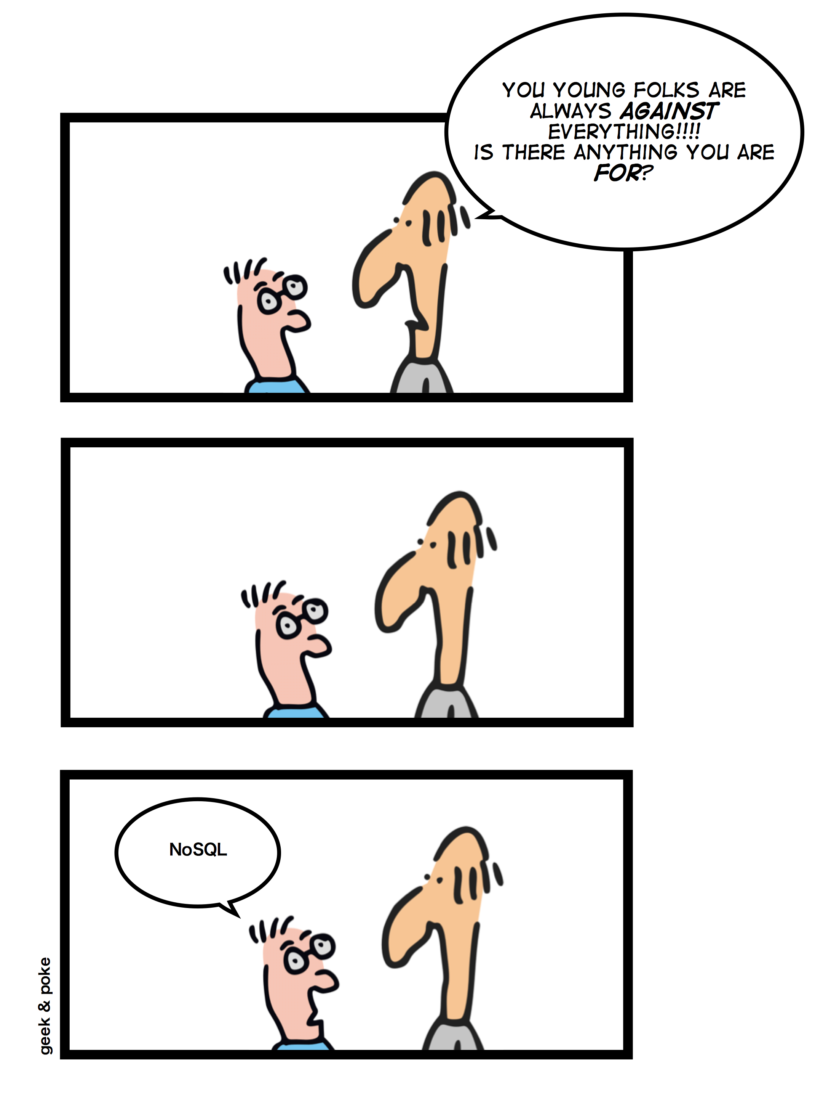
Summary

Slide 39
Summary
{
options: ["Embed", "Reference"],
rules: "There are no rules, merely guidelines",
embed: [
"1:1",
"Child is a dependent",
"Similar volatility",
"favor read speed"
]
reference: [
"related data changes frequently",
"many:many",
"favor writes"
]
remember: [
"Don't be scared to experiment and mix & match",
"Models change & evolve",
"Hybrid models"
]
}

Slide 40




Azure DocumentDB SDKs and Tooling
SDKs
Azure Portal
Studio
aka.ms/docdbsdks
portal.azure.com
aka.ms/docdbstudio
Notes:
DocumentDB offers SDKs and tooling to help you develop against and manage data in the service.
All APIs are accessible as REST over HTTP, we also provide .Net, Node, Java and Python SDKs
I already shown provisioning through the portal – the Azure Preview portal offers a variety of development, monitoring and management capabilities.
DocumentDB Studio is an open source app that allows you to manage and interact with the service from a GUI tool
The Data Migration tool allows you import existing data into DocumentDB

Slide 41






Get Started Today
select * from playground p where p.name = "DocumentDB"
explore playground
build an app
move some data
aka.ms/docdbplayground
aka.ms/docdbstarter
aka.ms/docdbimport

Slide 42

http://aka.ms/CloudDevelop
Dell Venue Pro 8
Enter by filling out survey
Announced at the end of the day.
Must be present to win.

Slide 43
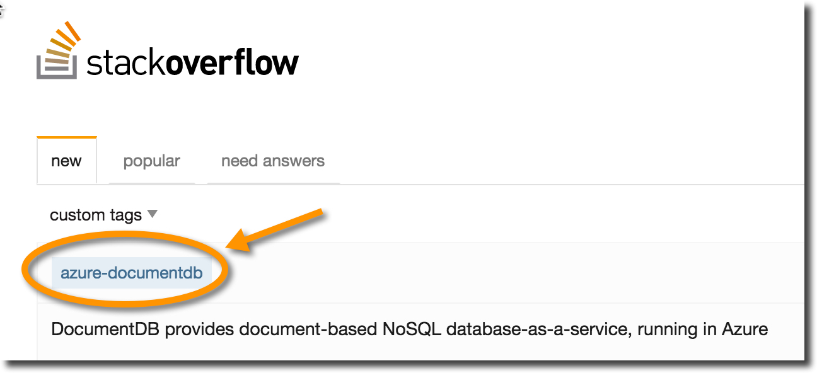
Wrapping up
documentdb.com
@DocumentDB
@dmakogon
@ryancrawcour

